Slide 1
Zomato restaurant insights
Subtle: Operational Analysis & Customer Preference Trends

Slide 2
Introduction
The Data Foundation Analyzing 10,000+ restaurants across 15 countries, backed by 1.2 million customer votes. This report represents a high-confidence view of the current food service landscape.
Key Objectives
Performance: Correlating Price vs. Ratings to understand value perception.
Demand: Identifying dominant Cuisines and Geographic strongholds.
Opportunity: Quantifying the untapped potential in Online Delivery.
The Bottom Line This analysis moves beyond simple metrics to provide actionable strategies for increasing revenue, optimizing menus, and expanding market reach.

Slide 3
OBJECTIVE
Evaluate Market Performance To assess the overall health of the restaurant ecosystem using key metrics: Average Ratings, Total Votes, and Cost for Two.
Analyze Customer Behavior To determine the correlation between Price Points and Customer Satisfaction, identifying which segments offer the highest perceived value.
Map Operational Footprint To visualize the Global Distribution of restaurants and pinpoint key markets vs. potential expansion zones.
Identify Growth Opportunities To quantify the gap in Online Delivery adoption and highlight specific cuisine categories for strategic investment.

Slide 4
DASHBOARD OVERVIEW
Market Coverage: The dashboard aggregates data from 10,000 restaurants globally.
Engagement Volume: A massive sample size of 1 Million customer votes ensures high data reliability.
Performance Baseline: The overall Average Rating of 2.9 indicates a significant opportunity for quality improvement across the platform.
Top Trends:
Cuisine: North Indian food dominates the market supply (40% of listings).
Delivery: A critical service gap exists, with ~74% of restaurants missing online delivery options.

Slide 5
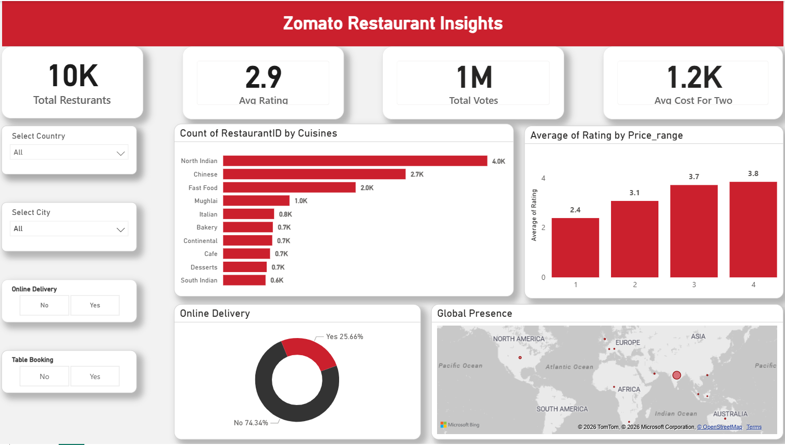

Slide 6
Key Performance Indicators (KPIs)
Market Size: 10K Total Restaurants tracked.
Customer Engagement: 1 Million Total Votes recorded, indicating high user interaction.
Average Rating: 2.9 out of 5 – This highlights a potential area for quality improvement across the platform.
Cost Benchmark: 1.2K Average Cost for Two people, placing the average dining experience in the mid-range affordability bracket.

Slide 7
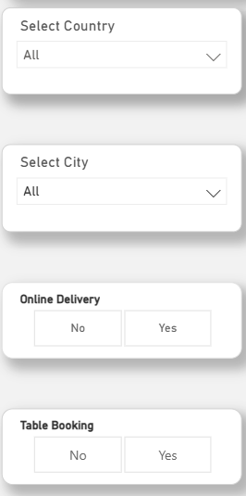
The Country & City filters allow users to drill down from global trends to hyper-local insights (e.g., comparing New Delhi vs. London).
Business Model Isolation:
The Online Delivery and Table Booking toggles let us separate different restaurant types (e.g., Cloud Kitchens vs. Fine Dining) to compare their specific performance.
Strategic Value:
These controls transform the dashboard from a static report into a dynamic tool, enabling stakeholders to answer specific, ad-hoc business questions instantly.

Slide 8
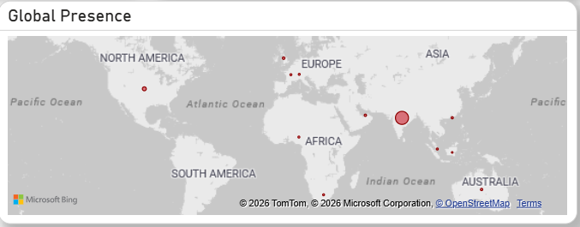
India-Centric Core: The massive concentration in India confirms it as the undisputed operational engine and primary revenue driver.
Strategic Global Outposts: Established footprint in high-value markets like the USA, UK, UAE, and Australia, proving the brand's international transferability.
The Scale Opportunity: The vast "white space" in the Americas and Europe highlights immense untapped potential for future international expansion.

Slide 9
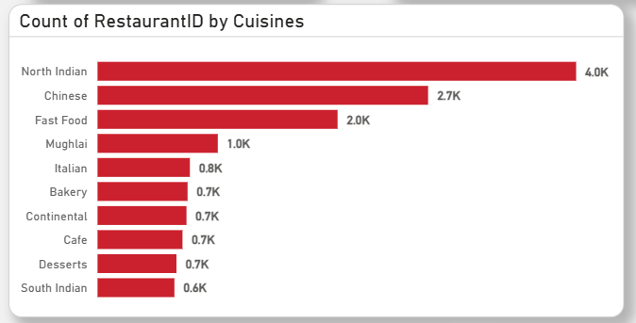
Key Insights:
The "Big Two" Dominance
North Indian cuisine is the undisputed market leader with ~4,000 restaurants (40% of total supply).
Chinese follows as a strong second with ~2,700 restaurants, cementing these two as the staple diets of the user base.
Fast Food & Convenience
Fast Food ranks third (2.0K), indicating a high demand for quick-service and affordable dining options.
Niche Market Opportunities
Categories like Italian (0.8K), Bakery (0.7K), and Continental (0.7K) have significantly lower saturation. This represents a potential "blue ocean" for new restaurants looking to avoid the fierce competition in North Indian cuisine.

Slide 10
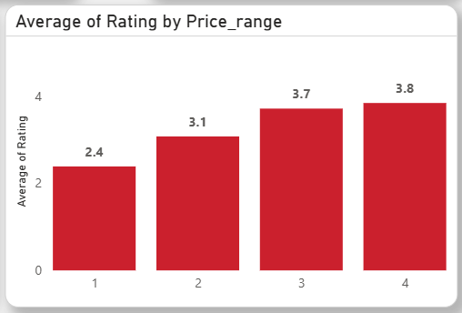
Linear Correlation: Higher Price = Higher Rating. Customers consistently rate premium experiences significantly better than budget ones.
The Budget Trap (Range 1): Lowest price bracket averages a poor 2.4 rating, signaling severe quality control issues that drag down the platform average.
The Quality Leap (Range 1 → 2): Best ROI on satisfaction: A moderate price increase yields the massive +0.7 rating jump (2.4 to 3.1).
Diminishing Returns: Premium benefits plateau. The rating gap between Range 3 (3.7) and Range 4 (3.8) is negligible.

Slide 11
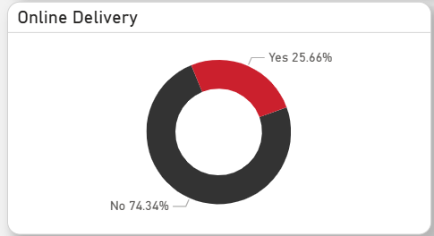
Low Adoption (25%): Despite the delivery boom, only 1 in 4 restaurants are currently capitalizing on it.
The Massive Gap (74%): 74% of the network operates as "Dine-In Only," effectively capping their revenue potential.
Strategic "Low-Hanging Fruit": We don't need new restaurants to grow. Simply enabling delivery for existing partners is the fastest way to drastically increase transaction volume.

Slide 12
CONCLUSION
The Reality: We have massive scale (10K Restaurants, 1M Votes), but our 2.9 average rating is a red flag.
The Insight: Price drives Quality. Premium restaurants consistently outperform budget outlets.
The Opportunity: 74% of our ecosystem is offline. Online Delivery is a massive, untapped revenue engine.
The Strategy: Stop chasing new restaurants. Instead, activate delivery for the existing ones and fix quality in the budget sector.

Slide 13
THANK YOU

